Slide 1
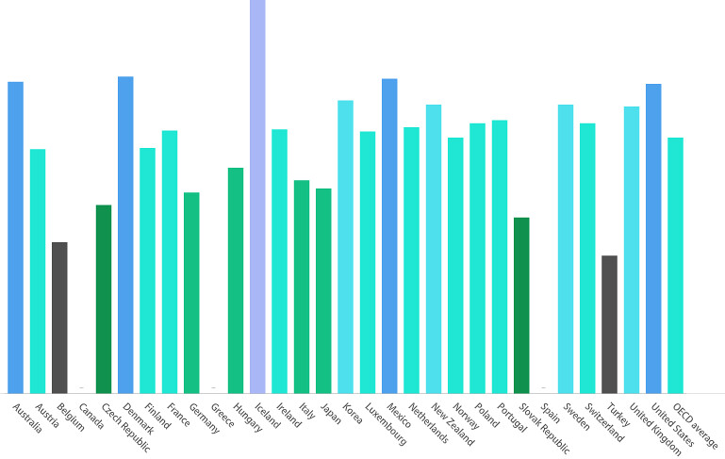
The Great Resignation Analysis
Contributing Members:
Gus Sanchez
Marc Palumbo
Roxann Lopez
Heather Bailey
Notes:
Heather - Welcome to The Great Resignation Analysis! Im Heather Bailey, and our group members are Gus, Marc and Roxann.

Slide 2



Topic Selection
Notes:
Heather - What is the Great Resignation? An ongoing economic trend in which employees have voluntarily resigned from their jobs en masse, beginning in early 2021 in the wake of the COVID-19 pandemic.

Slide 3




Background
Manufacturing
Healthcare
Education
Notes:
Heather - Since COVID 19, economists and institutions have analyzed a recent economic and cultural phenomena of people voluntarily resigning from their jobs. Many have speculated as to why individuals have become more willing to leave their current employers, and we hope to provide some evidence and possibly some answers for this after analyzing the data we have discovered. For our project, we will be focusing on the U.S. workforce, primarily in the manufacturing, healthcare and hospitality, and education sectors.

Slide 4

Motivation
We chose this topic as a group because it has affected everyone in the country in one way or another. COVID-19 changed the world, and certain things will never be the same. Employment rates plummeted, unemployment claims went through the roof, and in turn our economy has suffered a significant negative impact, and will likely continue to suffer for years to come. Understanding the contributing factors to the Great Resignation will enable us to understand our country and our people as a whole, and better predict future economic trends.
Notes:
Heather - We chose this topic as a group because it has affected everyone in the country in one way or another. COVID-19 changed the world, and certain things will never be the same. Employment rates plummeted, unemployment claims went through the roof, and in turn our economy has suffered a significant negative impact, and will likely continue to suffer for years to come. Understanding the contributing factors to the Great Resignation will enable us to understand our country and our people as a whole, and better predict future economic trends.

Slide 5




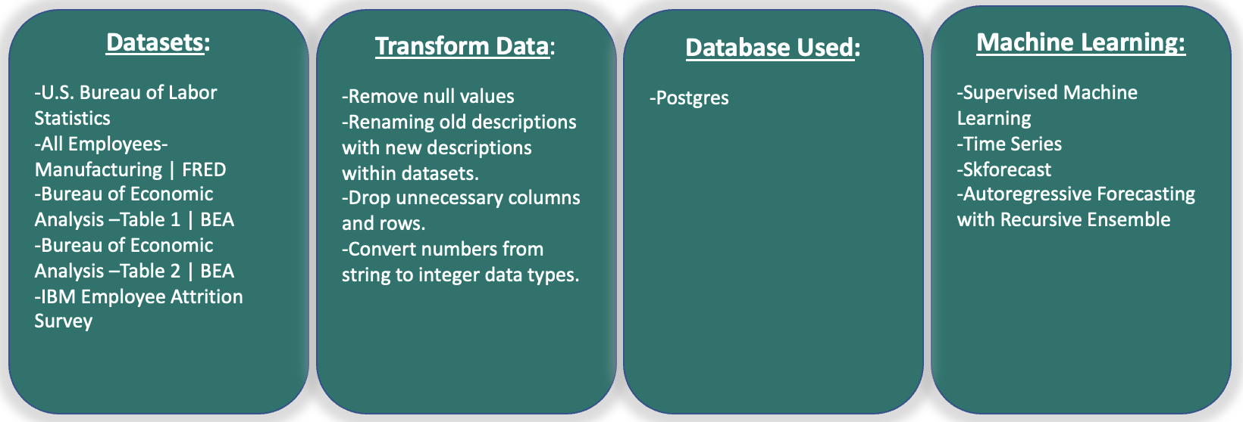
Data Sources
All Employees- Manufacturing | FRED
BEA | Bureau of Economic Analysis Table
BEA | Bureau of Economic Analysis Table 2
U.S. Bureau of Labor Statistics
Kaggle | HR Analytics Attrition
Notes:
Heather - We used multiple data sets for our analysis. We performed ETL on The Kaggle dataset on HR Analytics Attrition and the economic data from FRED, and used the Bureau of Economic Analysis tables for our machine learning portion.

Slide 6
Questions we hope to answer:
?
What are the contributing factors to individuals resigning from their jobs?
What will future U.S. economic trends look like?
What industries will be most impacted in the future by resignations?
Notes:
Heather - The questions we set out to answer were: What are the contributing factors to individuals resigning from their jobs? What will future U.S. economic trends look like? And What industries will be most impacted in the future by resignations?

Slide 7

Employee Attrition
The Five R’s
Retirement
Relocation
Reconsideration
Reshuffling
Reluctance
Notes:
Roxann - Employee attrition measures how many workers are voluntarily or involuntarily leaving their jobs for many reasons. During the COVID-19 pandemic, there was a mass exit in the workforce that is widely known as the Great Resignation. There are various contributing factors, but they can be broken down into five categories known as The Five R’s. Retirement, relocation, reconsideration, reshuffling, reluctance.

Slide 8

Retirement
Notes:
Roxann - Older employees retiring at accelerated rates during pandemic. Some even retiring early.

Slide 9

Relocation
Notes:
Roxann - People relocating from larger cities to smaller ones in hope for less stressful lifestyle.

Slide 10

Reconsideration
Notes:
Roxann - People quitting their jobs as their values no longer align with the companies. Toxic work cultures.

Slide 11

Reshuffling
Notes:
Roxann - Employees are searching for better wages, location, company work culture, and flexibility with work hours.

Slide 12

Reluctance
Notes:
Roxann - Work from home has become the new normal during pandemic. Individuals do not want to work in the office any more. Better work/life balance.

Slide 13
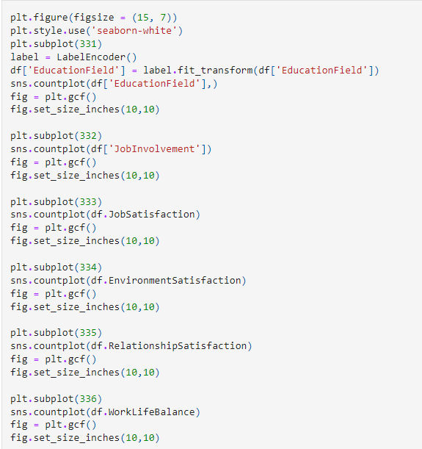
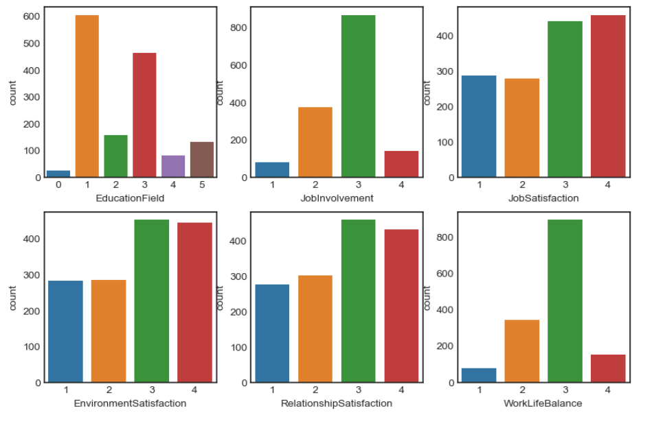
IBM Employee Survey
Data exploration phase: person 1 present
Notes:
Roxann - IBM surveyed approx 1400 of their employees.
Here are 6 subplots of the data provided from that survey.
Education Field: (1) Below College, (2) College, (3) Bachelor, (4) Master, (5) Doctor
Job Involvement, Job Satisfaction, Environment Satisfaction, & Relationship Satisfaction: (1) Low, (2) Medium, (3) High, (4) Very High
Work/Life Balance: (1) Bad, (2) Good, (3) Better, (4) Best

Slide 14
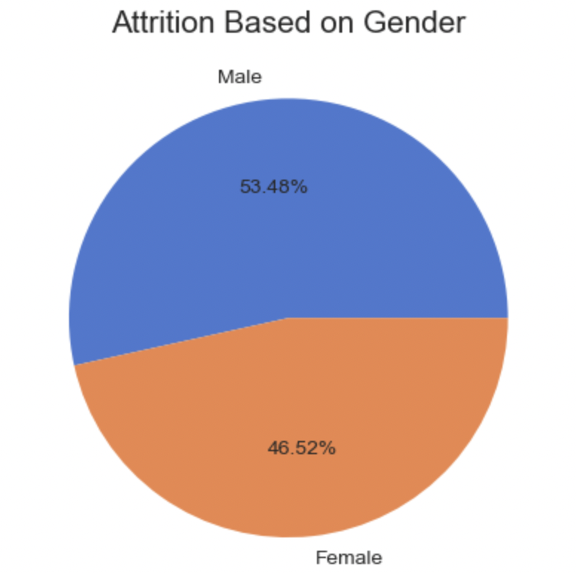
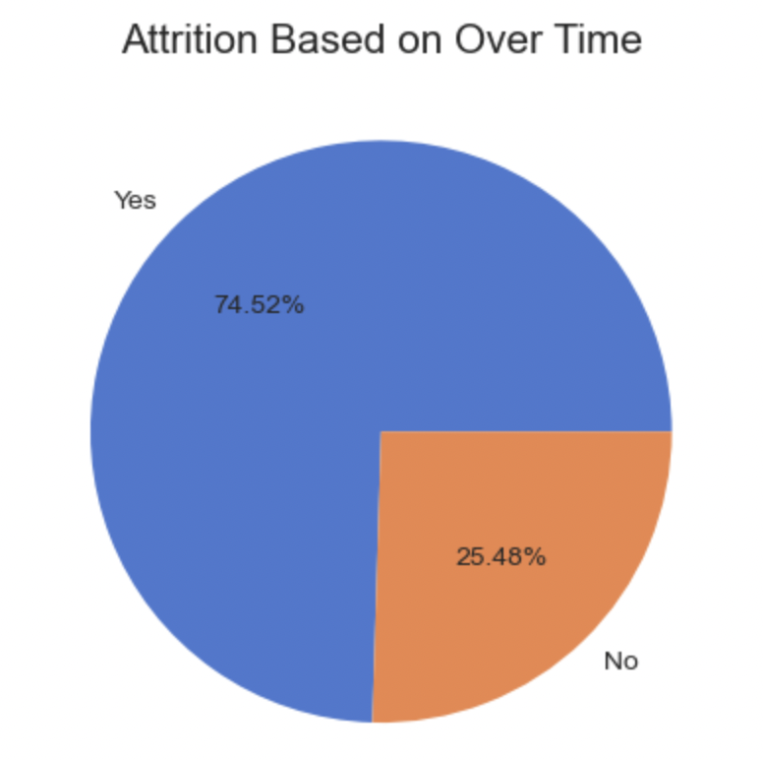
IBM Employee Survey
Notes:
Roxann - Men are experiencing attrition more than women, overtime plays a big factor in discontent.

Slide 15
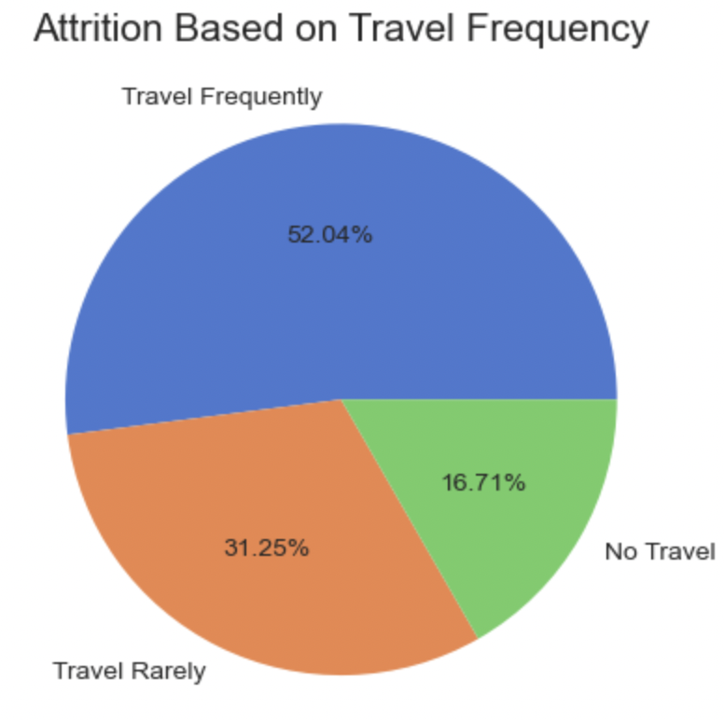
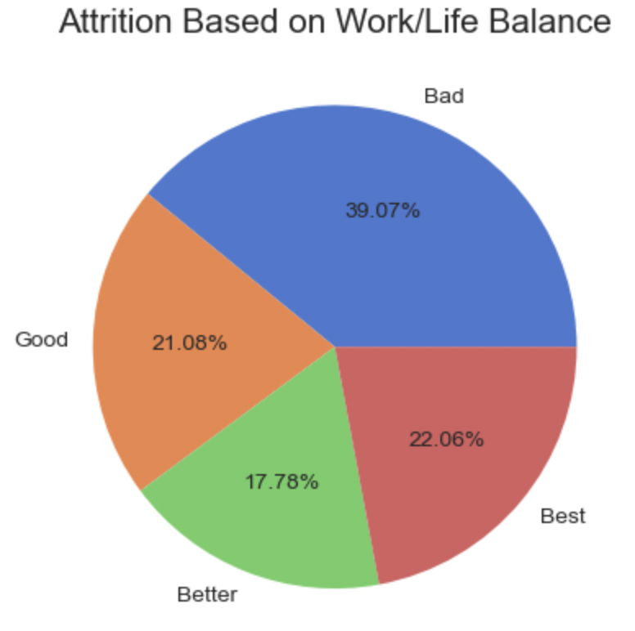
IBM Employee Survey
Notes:
Roxann -spending more time away from home causes employees to experience attrition.

Slide 16
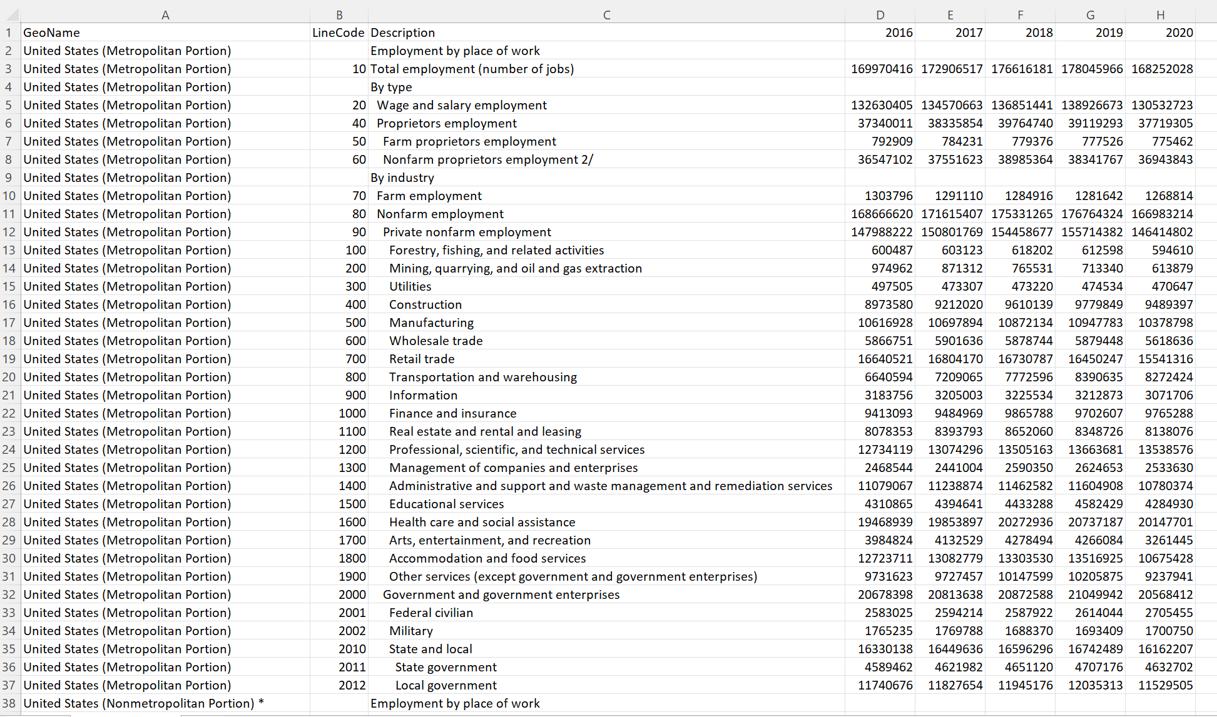
Data Cleaning / ETL
Raw Geographic Data
Notes:
Marc - Here we have the raw data from the FRED employees dataset. One of the biggest challenges we faced in week one was gathering usable data that supported the project. Before starting we were optimistic that there would be an abundance of data to choose from that would support our initial thoughts on the subject. We turned out to be wrong and realized that this part of our project would take more time than we had projected. Thankfully we discovered this dataset containing (describe).

Slide 17
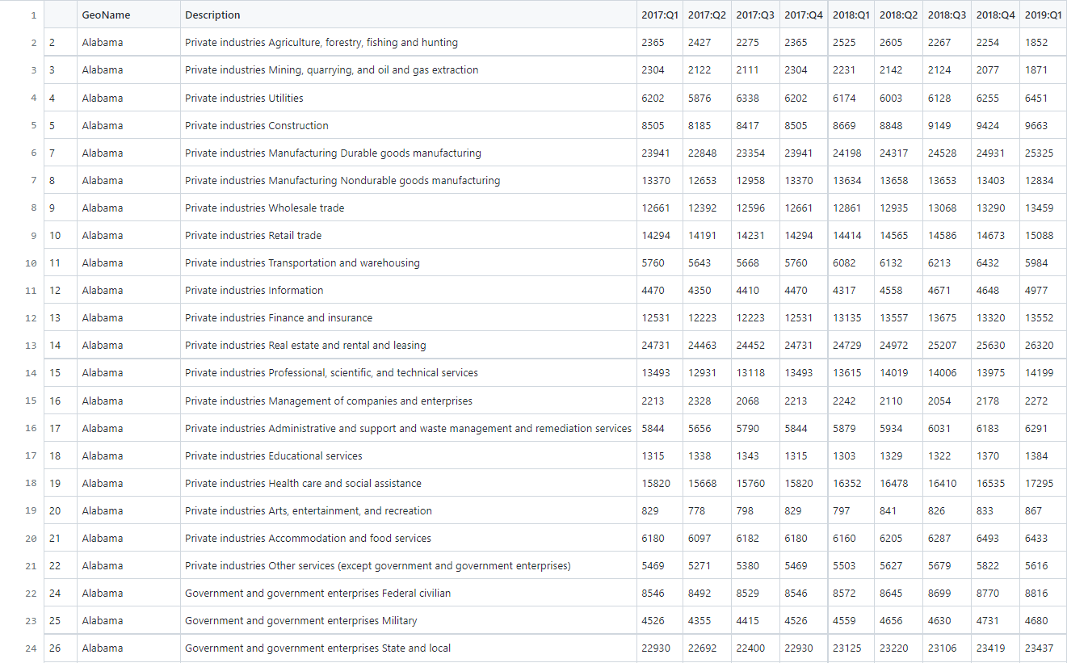
Data Cleaning / ETL
Cleaned Geographic Data
Notes:
Marc - (Describe)

Slide 18
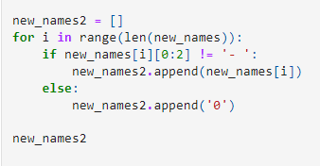
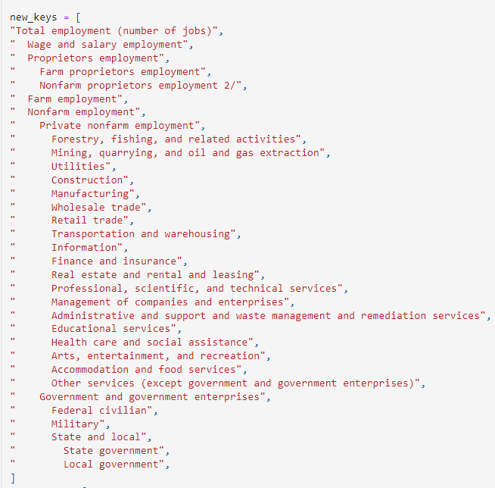
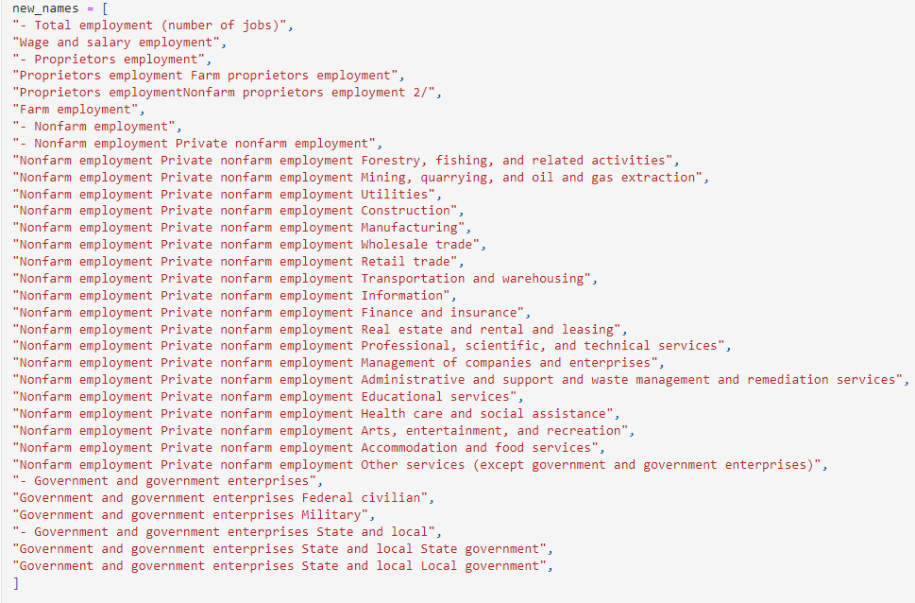
Data Cleaning / ETL
Notes:
Marc - (Describe)

Slide 19
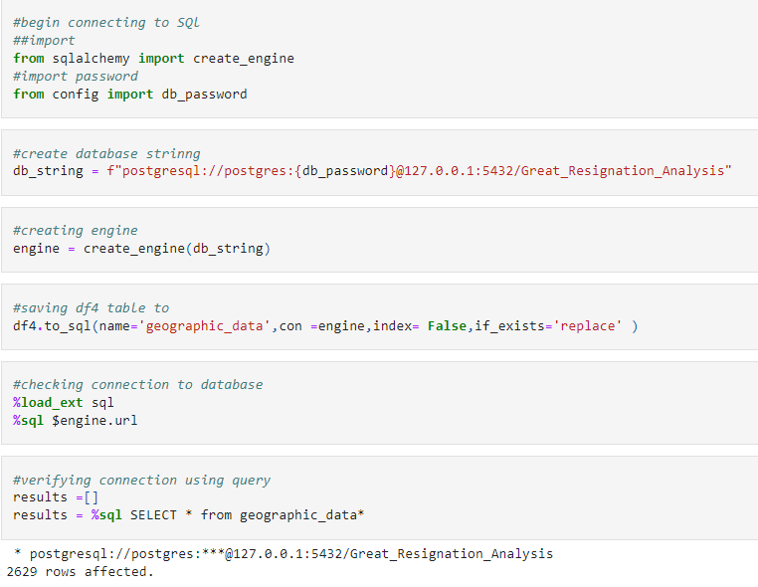
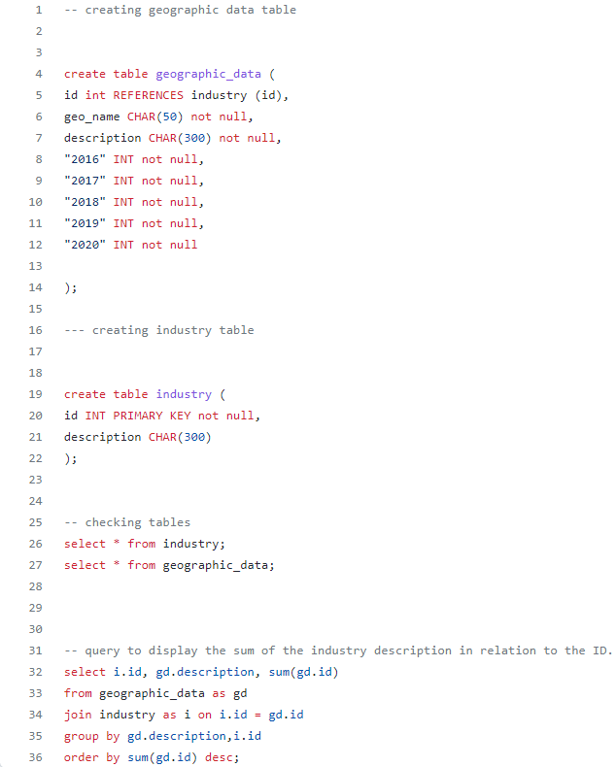
Database / SQL
Notes:
Marc - (Describe)

Slide 20
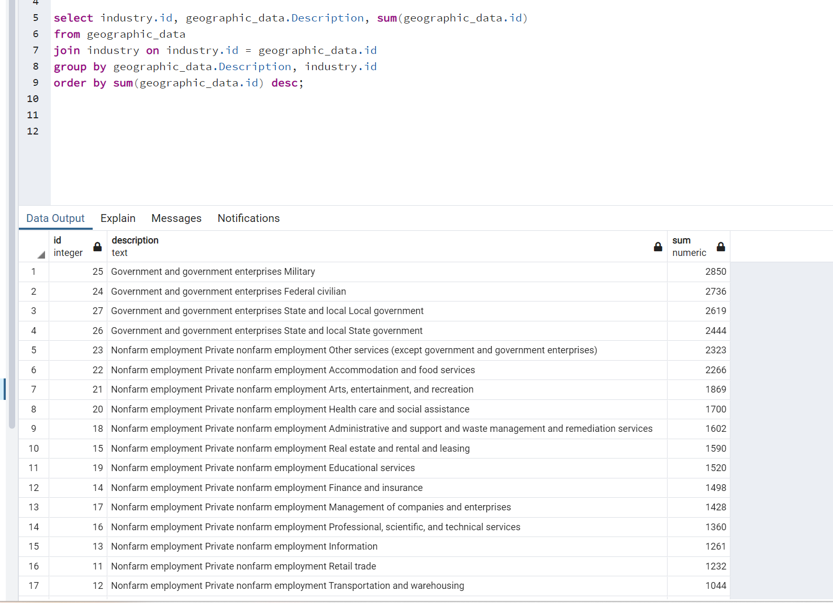
Database / SQL
Notes:
Marc - (Describe)

Slide 21
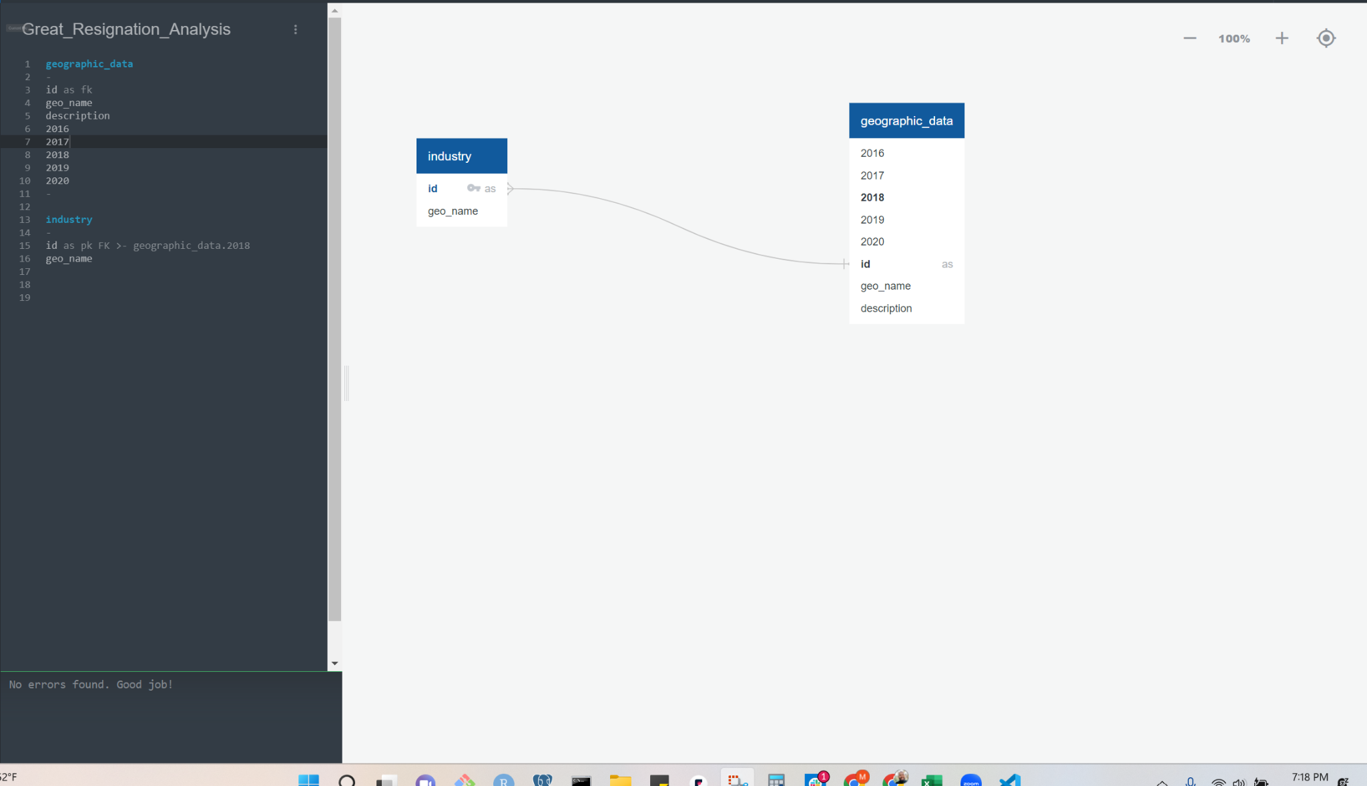
Database / SQL
Notes:
Marc - (Describe)

Slide 22
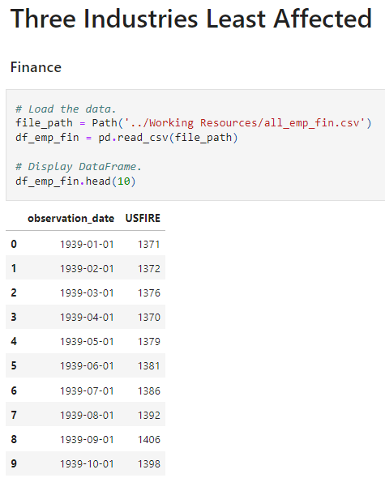
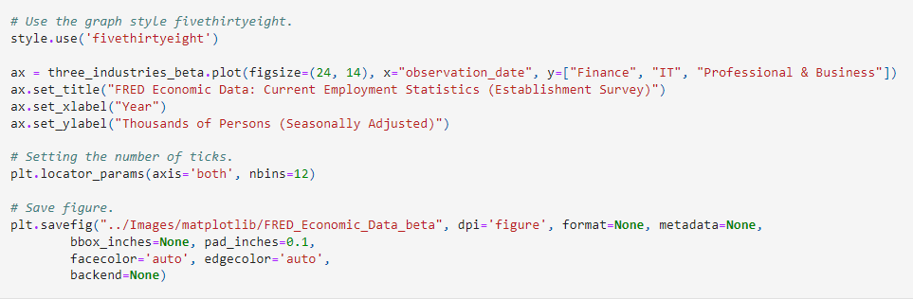
Data Cleaning / Visualization
Notes:
Gus - Finance, It, and Professional and Business categories

Slide 23
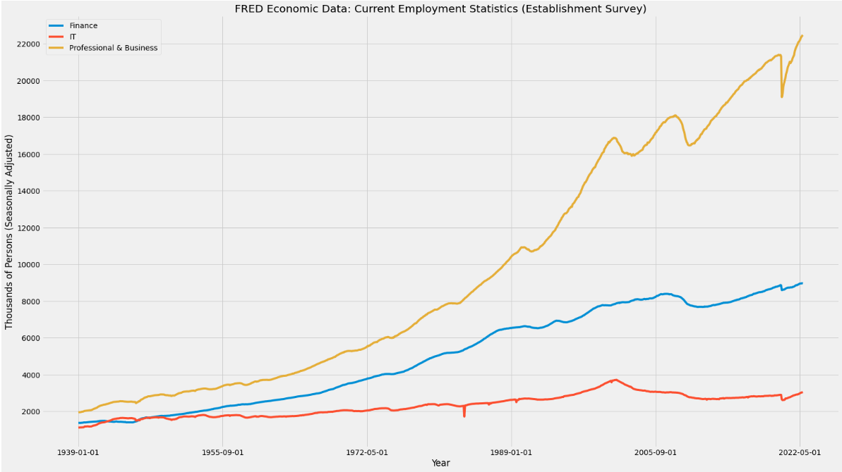
Notes:
Gus -

Slide 24
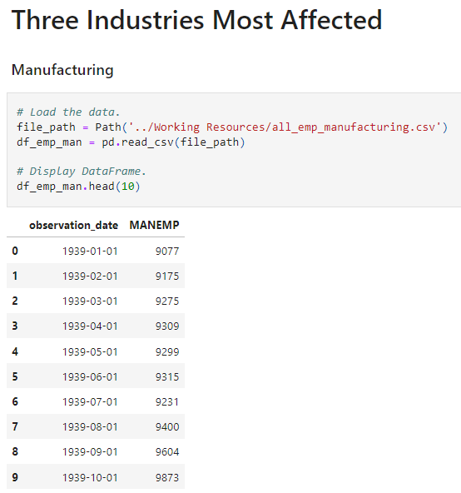
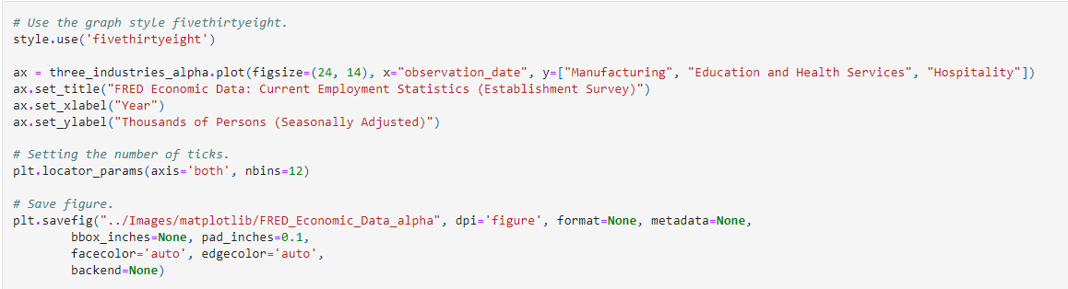
Data Cleaning / Visualization
Notes:
Gus - Manufacturing, Education and Health, and Hospitality.

Slide 25
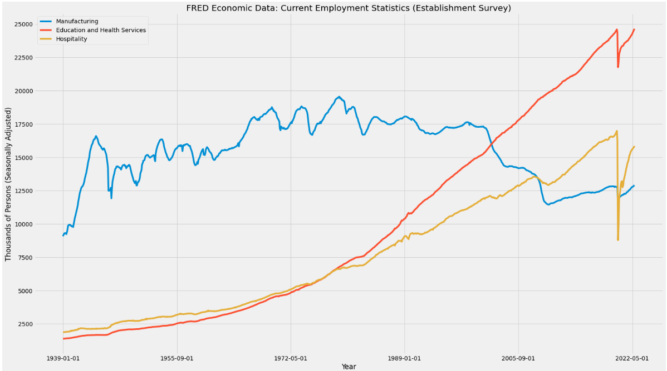
Notes:
Gus -

Slide 26
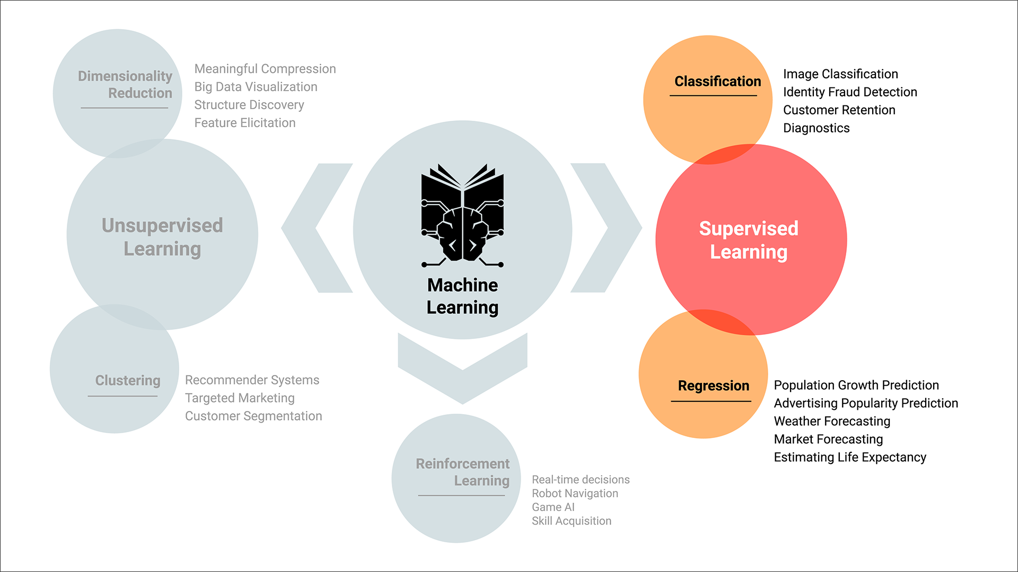
Machine Learning
Notes:
Gus -

Slide 27
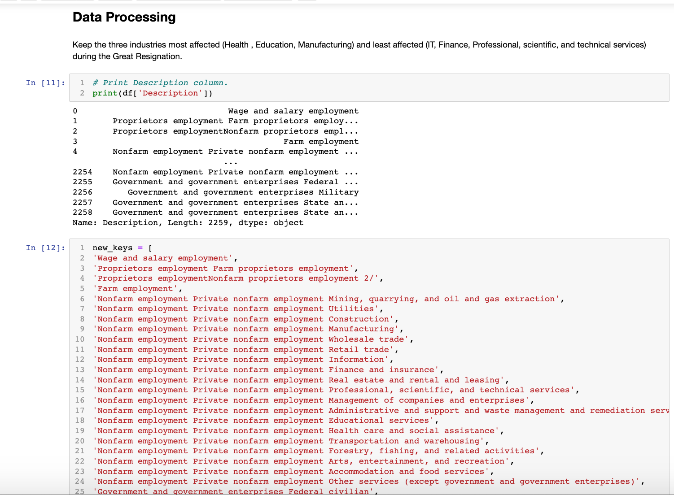
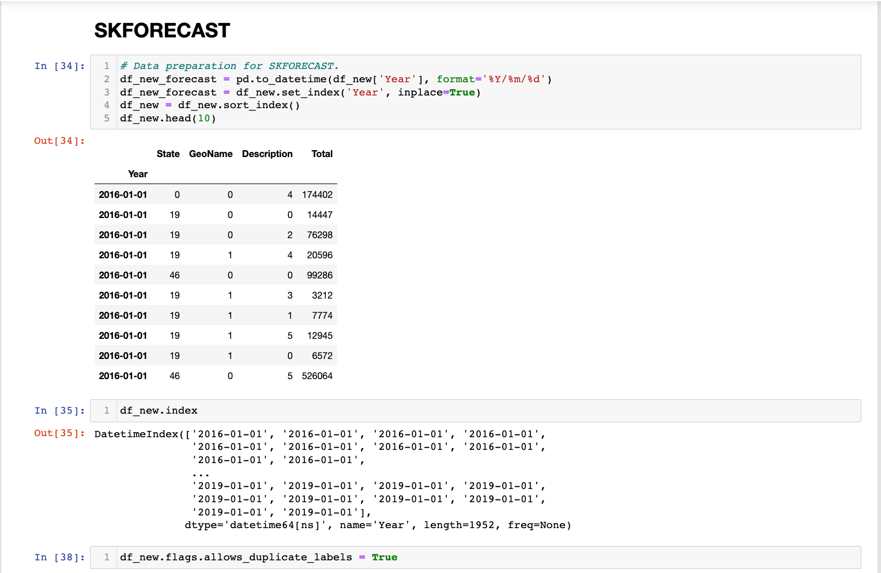
Machine Learning
Notes:
Gus -

Slide 28
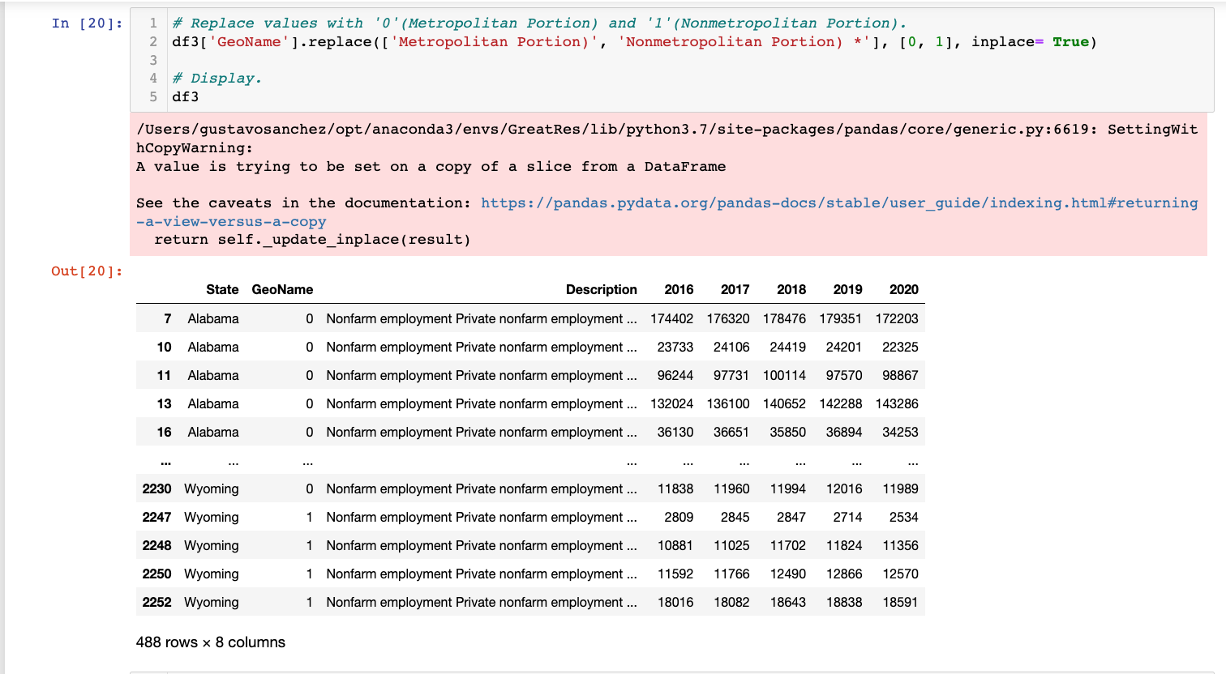
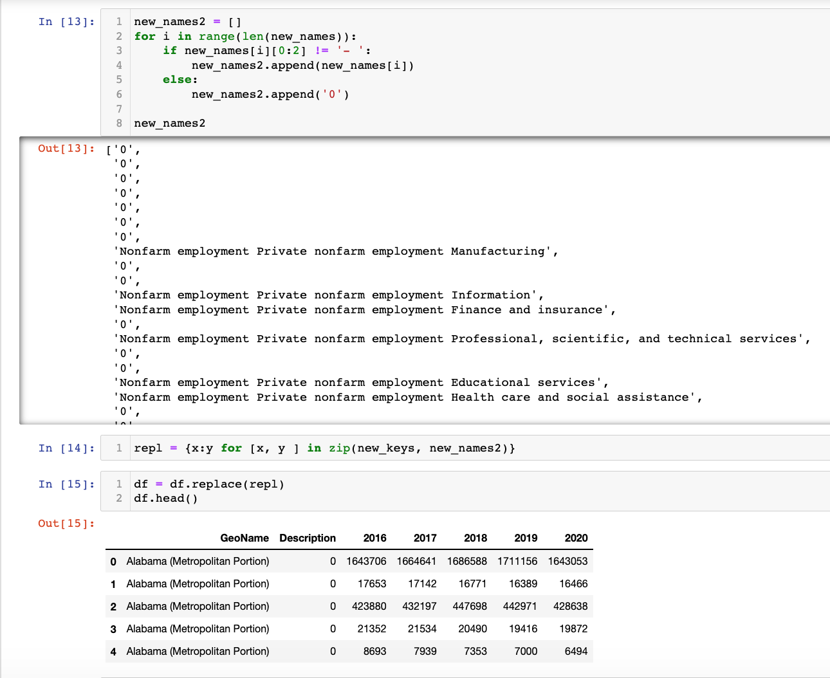
Machine Learning
Notes:
Gus -

Slide 29
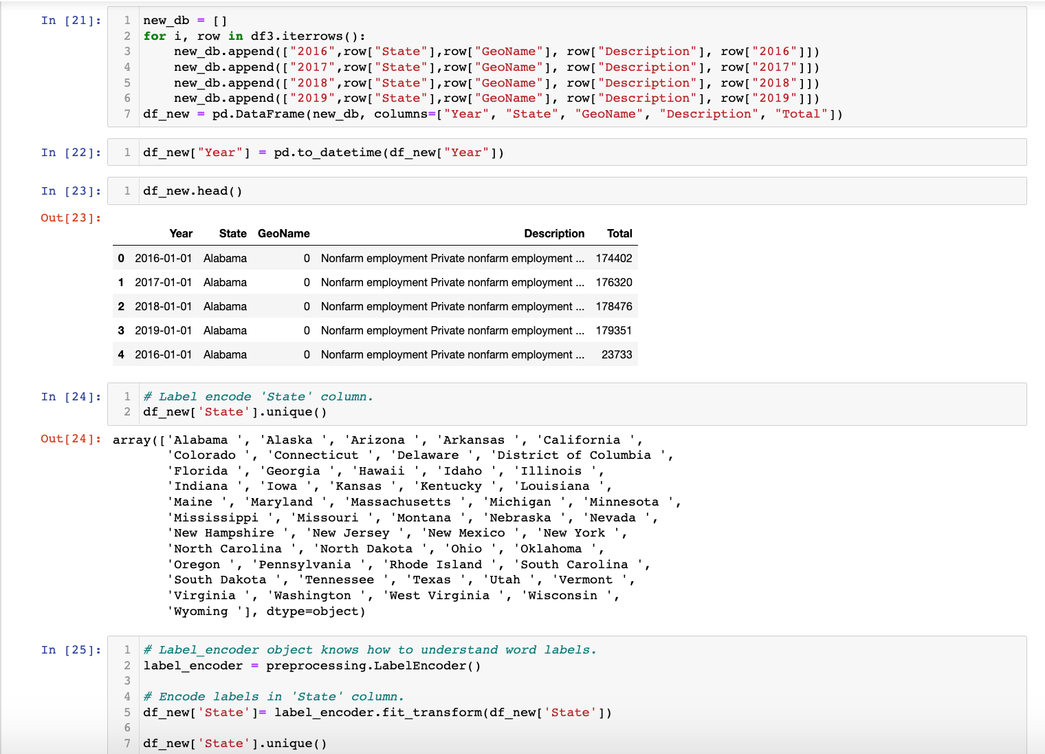
Machine Learning
Notes:
Gus -

Slide 30
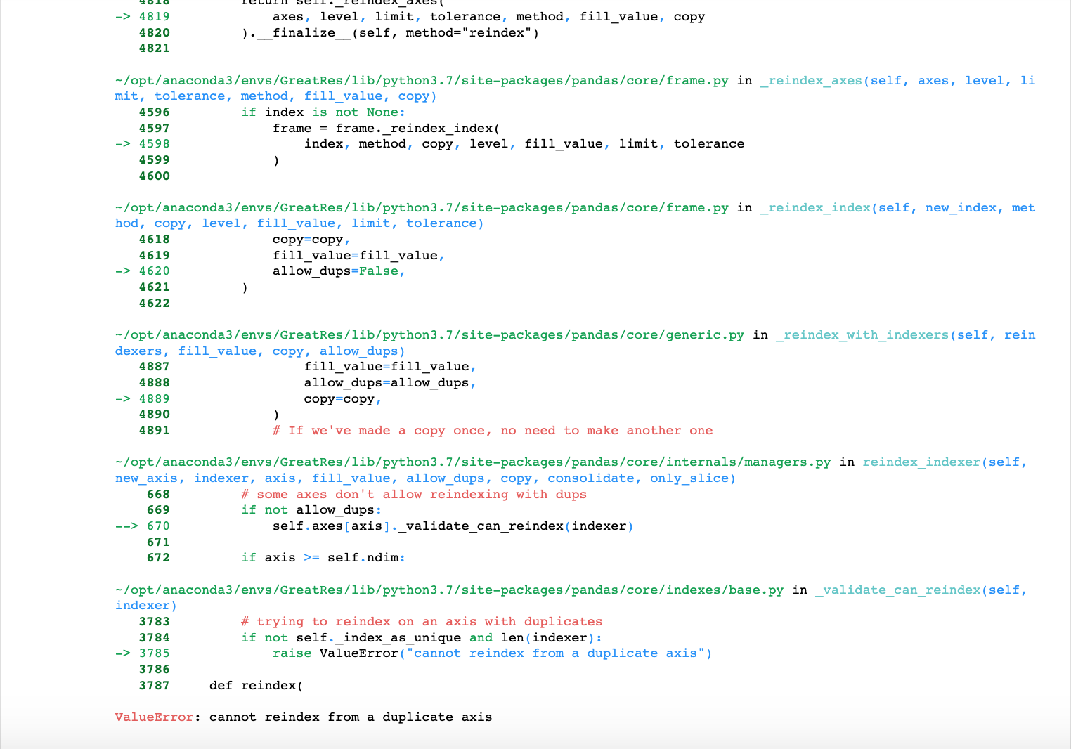
Machine Learning
!
!
Notes:
Gus -

Slide 31
Tableau
Link to Dashboard

Slide 32
Future Recommendations
What would be do differently?
Research topic thoroughly beforehand
Don’t make assumptions

Slide 33
Conclusion
What did we set out to do, what obstacles did we encounter, what did we acheive

Slide 34
Technologies & Languages
Python SKForecast
SQL Quickdatabasediagrams.com
Postgres Numpy
Jupyter Notebook Sklearn
Matplotlib Tableau
Pandas

Slide 35

Questions?

Slide 36
Appendix

